Slide 1
DIVIDING
POLYNOMIALS

Slide 2
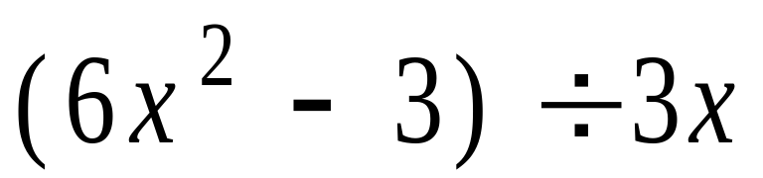

Dividing Polynomials
The objective is to be able to divide a polynomial by a monomial.

Slide 3

Step 1
Divide each term of the polynomial by the monomial.
x
2
6
3
−
3
x
3
x

Slide 4

Step 2
Write in simplified form.
1
2
x
−
x

Slide 5
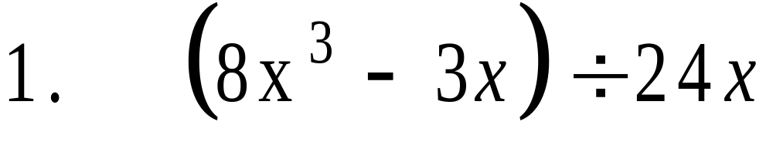
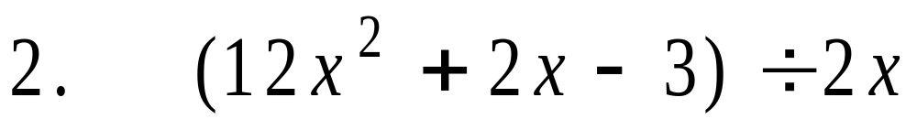

You Try It
A
A

Slide 6
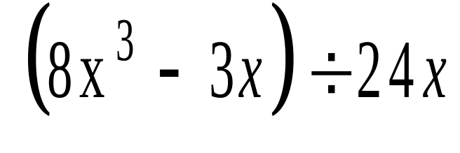
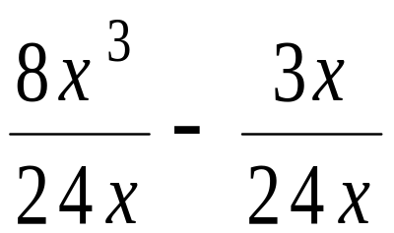
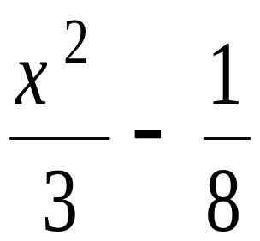

You Try It
Problem 1
Divide each term of the polynomial by the monomial.
Write in simplified form.

Slide 7
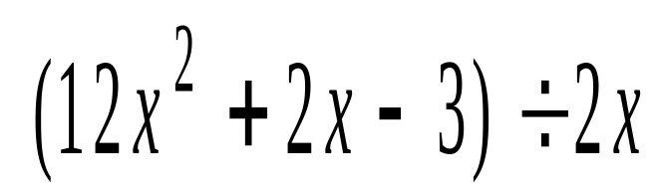
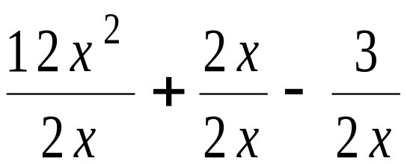
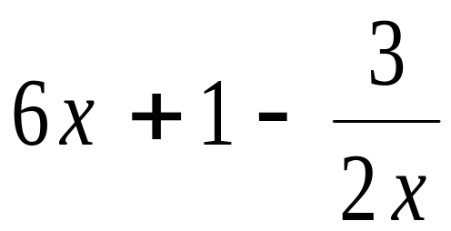
You Try It
Problem 2
Divide each term of the polynomial by the monomial.
Write in simplified form.

Slide 8
Dividing a Polynomial by a Polynomial
The objective is to be able to divide a polynomial by a polynomial by using long division.
Dividend – the number which is being divided.
Divisor – The number that is being divided into the dividend.
Quotient – The result obtained when numbers or expressions are divided.
Remainder – The part that is left over when the divisor no longer goes into the dividend a whole number of times.

Slide 9
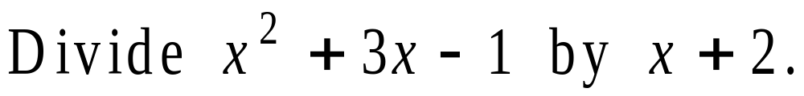
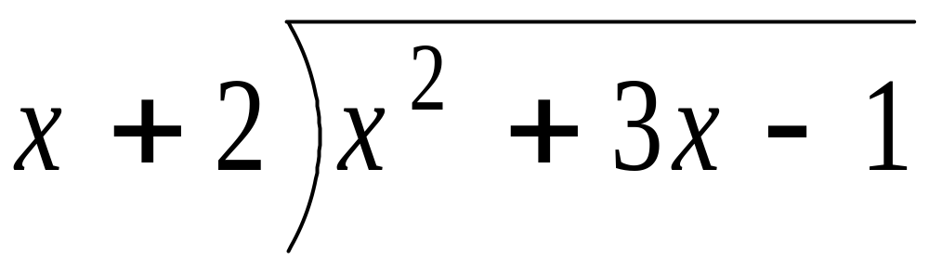
Polynomial Long Division
Step 1: Write it as you would a regular long division problem.
The x+2 is the divisor and the x²+3x-1 is the dividend.

Slide 10
Step 2
x
Divide x² by x to get x. Place this on top.
x
+
2
x
2
+
3
x
−
1
Multiply x+2 by x to get x² +2x.
x
2
+
2
x
Subtract the x²+2x from the x²+3x-1.
x
−
1

Slide 11
Step 3
x
+
1
Divide the x by x to get 1.
x
+
2
x
2
+
3
x
−
1
Multiply x+2 by 1 to get x+2.
x
2
+
2
x
x
−
1
x
+
2
Subtract x+2 from the x-1.
−
3

Slide 12
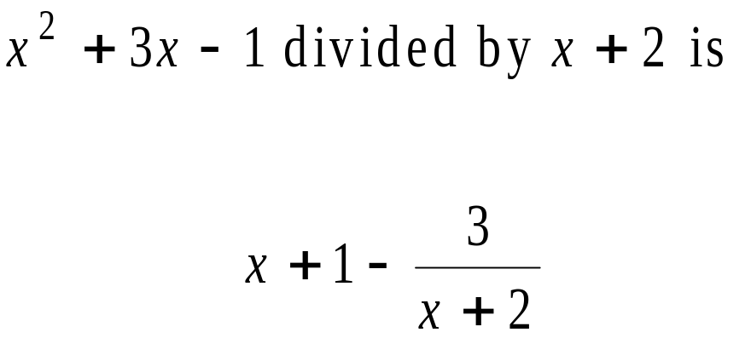

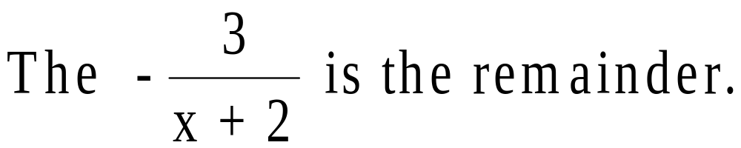
Step 4
Write your final answer.
The x+1 is the quotient.

Slide 13
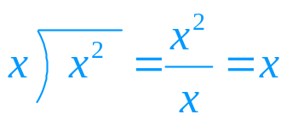
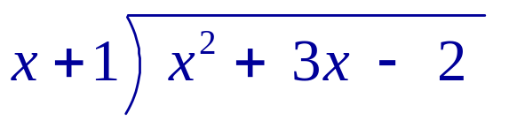


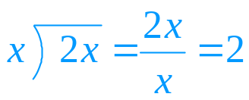


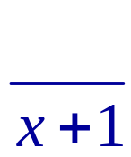
Example: Divide & Check
Example: Divide x² + 3x – 2 by x – 1.
x
+ 2
1.
2.
x² + x
2x
– 2
3.
2x + 2
4.
– 4
5.
remainder
6.
– 4
Answer: x + 2 +
Copyright © by Houghton Mifflin Company, Inc. All rights reserved.

Slide 14
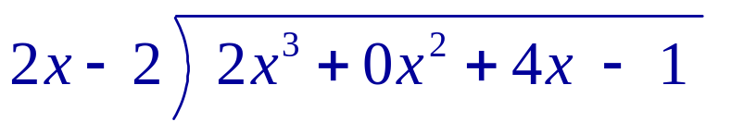
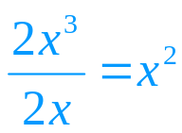

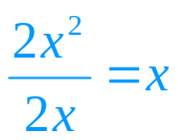


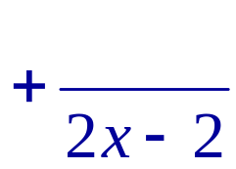

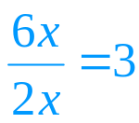

Example: Divide & Check
Example: Divide 4x + 2x³ – 1 by 2x – 2.
x²
+ x
+ 3
Write the terms of the dividend in descending order.
2x³ – 2x²
Since there is no x² term in the dividend, add 0x² as a placeholder.
2x²
+ 4x
2x² – 2x
1.
2.
6x
– 1
6x – 6
3.
4.
5
5.
5
6.
Answer: x² + x + 3
7.
8.
9.
Copyright © by Houghton Mifflin Company, Inc. All rights reserved.

Slide 15
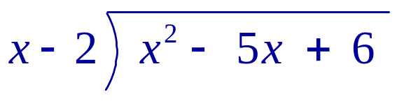
Example: Division With Zero Remainder
Example: Divide x² – 5x + 6 by x – 2.
x
– 3
x² – 2x
– 3x
+ 6
– 3x + 6
0
Answer: x – 3 with no remainder.
Copyright © by Houghton Mifflin Company, Inc. All rights reserved.

Slide 16
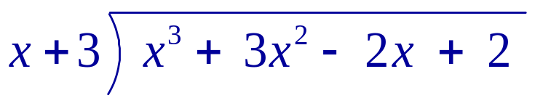
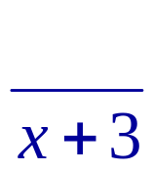
Example: Division With Nonzero Remainder
Example: Divide x³ + 3x² – 2x + 2 by x + 3 and check the answer.
x²
+ 0x
– 2
Note: the first subtraction eliminated two terms from the dividend.
x³ + 3x²
0x²
– 2x
+ 2
– 2x – 6
Therefore, the quotient skips a term.
8
8
Answer: x² – 2 +
Check: (x + 3)(x² – 2) + 8
= x³ + 3x² – 2x + 2
Copyright © by Houghton Mifflin Company, Inc. All rights reserved.

Slide 17
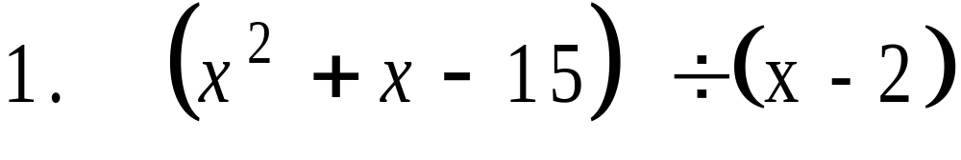
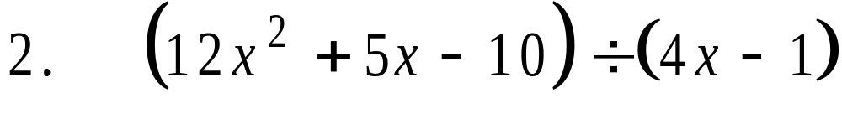

You Try It
A
A

Slide 18
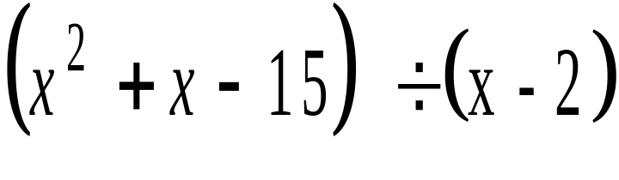
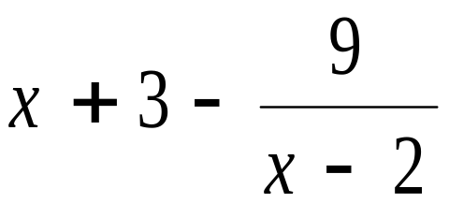
Problem 1
x
+
3
X² divided by x is x. Multiply x-2 by x.
x
−
2
x
2
+
x
−
15
x
2
−
2
x
Subtract
3
x
−
15
3x divided by x is 3. Multiply x-2 by 3.
3
x
−
6
−
9
Subtract
You Try It

Slide 19
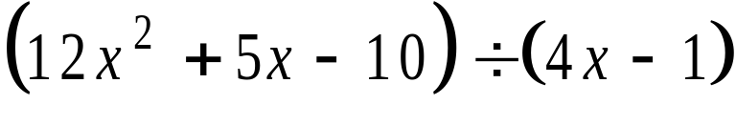
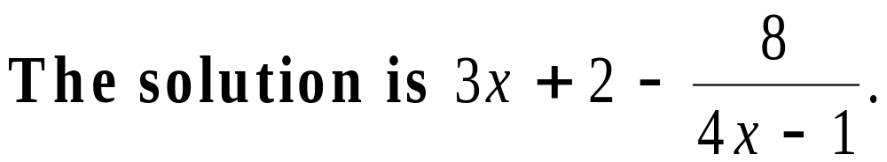

Problem 2
3
x
+
2
12x² divided by 4x is 3x.
Multiply 4x-1 by 3x.
4
x
−
1
12
x
2
+
5
x
−
10
12
x
2
−
3
Subtract
x
8
x
−
10
8x divided by 4x is 2. Multiply 4x-1 by 2.
8
x
−
2
−
8
Subtract
You Try It

